Slide 1
Creation and deployment of CI/CD
Continuous Integration
Continuous Delivery/Deployment

Slide 2
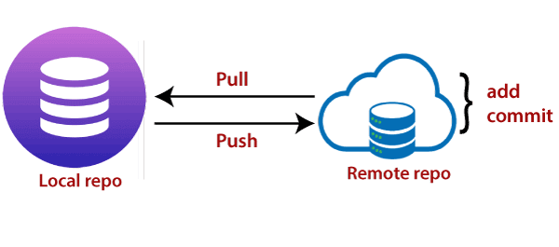
What is CI/CD?
Continuous Integration:
Continuous Integration is a practice followed by the developers.
Which includes time-to-time check-ins to a shared repository.
These checkings are called Push.
Each push is verified by an automated build to detect any problems early stage.
This helps to locate the problem more easily.
With CI, The integration happens after a “git push”, to a shared repository.
Continuous Delivery :
Continuous delivery (CD) picks up where continuous integration is over.
While CI is the process to build and test automatically. CD deploys all code changes to the testing or staging environment in the build.
CD aims to reduce the friction points in the deployment or release processes.
Team’s implementation involves automating each of the steps for build deployments.
So that a safe code release can be done at any moment in time.
To make CI/CD a reality, you need to automate everything that you can in the software delivery process.
And run it in a CI/CD Pipeline.

Slide 3
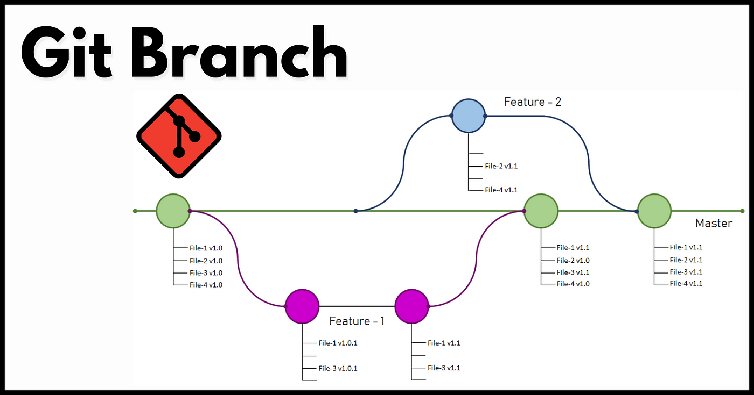
Stages of CI
Push to master every day
While working on any software, it is divided into the no of features.
Multiple developers work on the same feature which togetherly makes complete software.
CI practice is about pushing code into the master branch.
Because that’s the branch that is going to be used to release software.
This “push to master” stage is also known as trunk-based development.
Test
CI relies on an automated and reliable suite of tests.
These tests validate the code integrated by the developers.
You can include as many tests as you consider critical.
But to determine that, remember that CI’s purpose is to provide feedback as soon as possible. If a developer has to wait an hour to get feedback, it won’t work.
So Keep the CI loop as short as possible. You might have to lean heavily on unit testing and lightly on integration testing.
Fix the broken build
If you observe any build is broken, then fixing it should be the priority for the team over adding a new feature to it.
The idea behind fixing a broken build is that the build is always going to produce releasable working code.

Slide 4
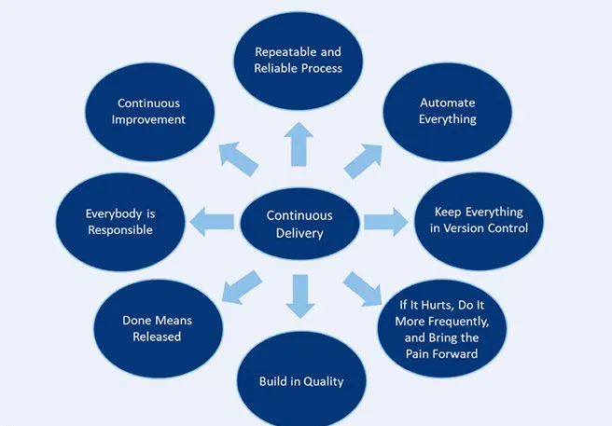
Principles of CD

Slide 5
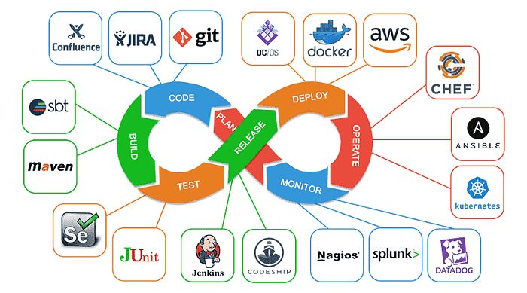
Tools, Stages Involved

Slide 6
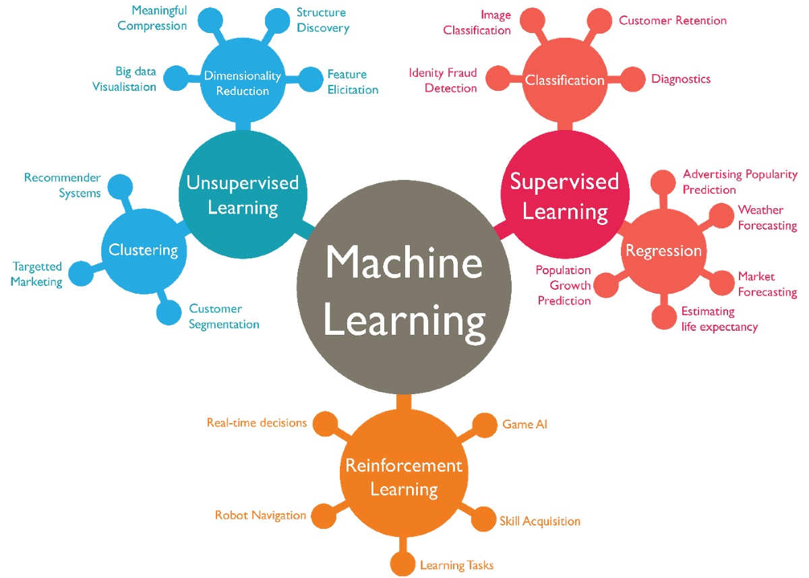
Reinforcement Learning
→ Learns from mistakes

Slide 7
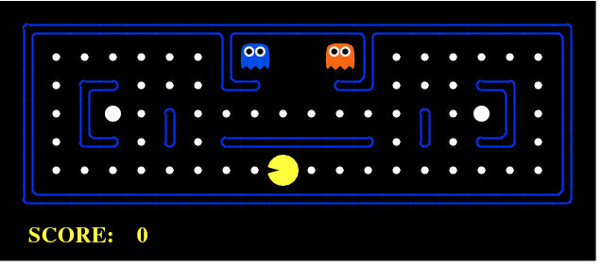
Example of RL
Goal: eat the food + avoid ghosts
Agent: Pacman
Reward: for eating food
Environment: Grid world
Punishment: For Dying (game lost)

Slide 8
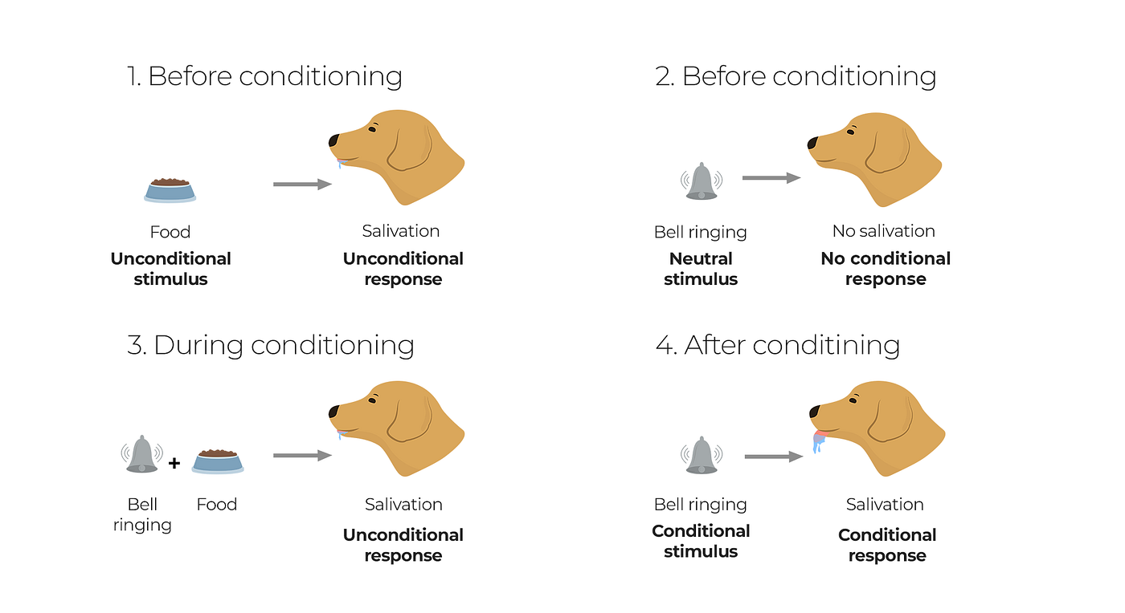
Ever heard of Pavlov’s dog?
In 1897 Ivan Pavlov, a russian physiologist, published his findings on conditioned behavior, that demonstrated how dogs could be conditioned to associate an unconditioned stimulus (food) with a neutral stimulus (bell), leading to a conditioned response (salivation) triggered by the bell alone.
The idea behind this experiment is that the dog could be conditioned to behave in a certain way according to a series of rewards or punishments it received, which is the central idea behind reinforcement learning.
Both Pavlov’s dog and reinforcement learning systems showcase the power of conditioning and the ability to adapt behaviors based on reinforcement signals.

Slide 9
What is Reinforcement Learning?
Reinforcement learning (RL) is a machine learning (ML) technique that trains software to make decisions to achieve the most optimal results.
It mimics the trial-and-error learning process that humans use to achieve their goals.
Think of positive reinforcement, negative reinforcement
E.g Pavlov dog
Software actions that work towards your goal are reinforced
While actions that detract from the goal are ignored.

Slide 10
Benefits of Reinforcement Learning
Excels in complex environments
RL algorithms can be used in complex environments with many rules and dependencies.
In the same environment, a human may not be capable of determining the best path to take, even with superior knowledge of the environment.
Instead, model-free RL algorithms adapt quickly to continuously changing environments and find new strategies to optimize results.
Requires less human interaction
In traditional ML algorithms, humans must label data pairs to direct the algorithm. When you use an RL algorithm, this isn’t necessary. It learns by itself.
At the same time, it offers mechanisms to integrate human feedback, allowing for systems that adapt to human preferences, expertise, and corrections.
Optimizes for long-term goals
RL inherently focuses on long-term reward maximization, which makes it apt for scenarios where actions have prolonged consequences.
It is particularly well-suited for real-world situations where feedback isn't immediately available for every step, since it can learn from delayed rewards.

Slide 11
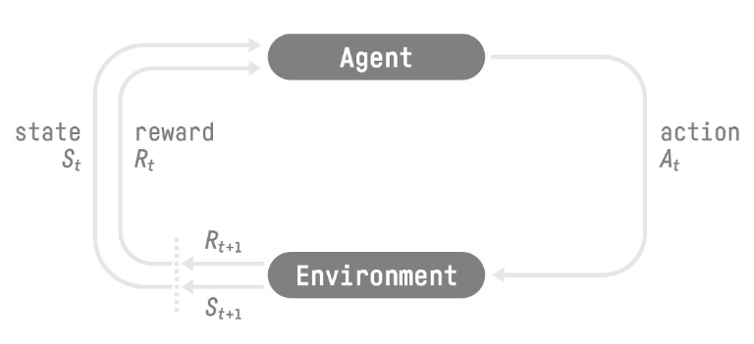
Understanding the concepts
Imagine you get a small puppy who you want to teach tricks to.
They will learn to do these tricks by trial and error, falling down, occasionally bumping into furniture (negative feedback) but also being praised by you and rewarded treats when they manage to make progress (positive feedback).
Over many attempts, they will progressively learn how to perform the tricks better and eventually on their own, without the need for the treats.
This is the phenomenon reinforcement learning tries to learn from.
St → State at time ‘t’
At → Action at time ‘t’
Rt → Reward at time ‘t’.
In the puppy example,
St → whatever position the dog is in at time t
At → which movement it is performing
Rt → Reward to whether or not you are going to feed him a treat.

Slide 12
Key concepts about RL
Agent is the ML algorithm (or the autonomous system)
Environment is the adaptive problem space with attributes such as variables, boundary values, rules, and valid actions
Action is a step that the RL agent takes to navigate the environment
State is the environment at a given point in time
Reward is the positive, negative, or zero value—in other words, the reward or punishment—for taking an action
Cumulative reward is the sum of all rewards or the end value
Based on Markov Decision Process
Uses discrete time steps
Builds if-then rules/policies based on trial-error
Based on it, action is decided
Exploration vs Exploitation tradeoff

Slide 13
Exploration vs Exploitation trade-off
In order to build an optimal policy,
the agent faces the dilemma of exploring new states
while maximizing its overall reward at the same time.
In other words, the agent must also choose between
further environment exploration to learn new state-action rewards
or
select known high-reward actions from a given state. This is called the exploration-exploitation trade-off.
This is called Exploration vs Exploitation trade-off.
To balance both, the best overall strategy may involve short term sacrifices.
Therefore, the agent should collect enough information to make the best overall decision in the future.

Slide 14
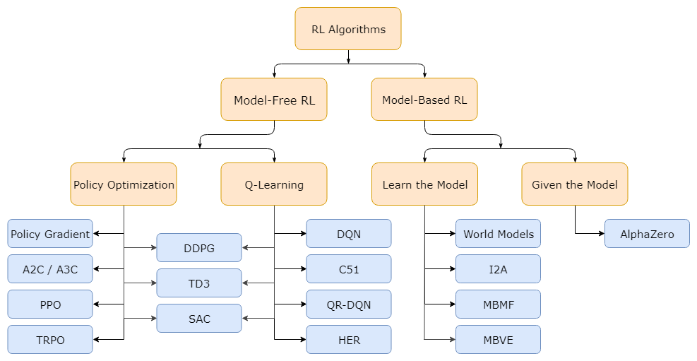
Types of RL
Does agent have access to (or learns) a model of the environment?
What to Learn?
Policies: Stochastic / Deterministic,
Action-value functions (Q-functions),
Value functions,
And/or Environment models.

Slide 15
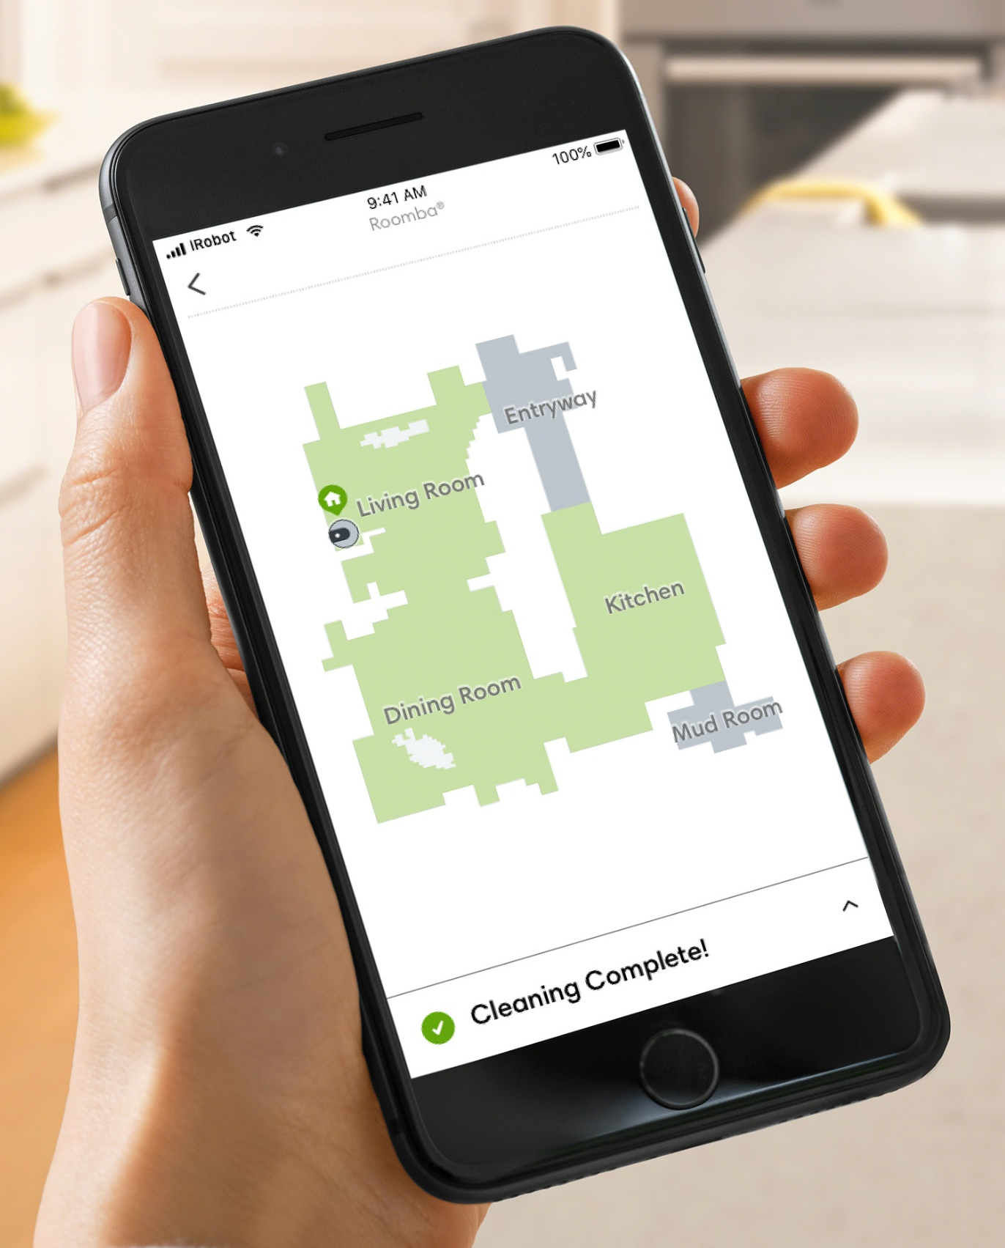

Model Based RL
Model-based RL is typically used when environments are well-defined and unchanging and where real-world environment testing is difficult.
The agent first builds an internal representation (model) of the environment. It uses this process to build this model:
It takes actions within the environment and notes the new state and reward value
It associates the action-state transition with the reward value.
Once the model is complete, the agent simulates action sequences based on the probability of optimal cumulative rewards. It then further assigns values to the action sequences themselves. The agent thus develops different strategies within the environment to achieve the desired end goal.
Example
Consider a robot learning to navigate a new building to reach a specific room.
Initially, the robot explores freely and builds an internal model (or map) of the building.
For instance, it might learn that it encounters an elevator after moving forward 10 meters from the main entrance.
Once it builds the map, it can build a series of shortest-path sequences between different locations it visits frequently in the building.
Downside: Ground-truth model of the environment is usually not available to the agent. If an agent wants to use a model in this case, it has to learn the model purely from experience, which creates several challenges.
The biggest challenge is that bias in the model can be exploited by the agent, resulting in an agent which performs well with respect to the learned model, but behaves sub-optimally (or super terribly) in the real environment
The Roomba transverses the house, identifies obstacles, and remembers which routes work best to clean the house.

Slide 16
Model Free RL
Model-free RL is best to use when the environment is large, complex, and not easily describable.
It’s also ideal when the environment is unknown and changing, and environment-based testing does not come with significant downsides.
The agent doesn’t build an internal model of the environment and its dynamics.
Instead, it uses a trial-and-error approach within the environment. It scores and notes state-action pairs—and sequences of state-action pairs—to develop a policy.
Example
Consider a self-driving car that needs to navigate city traffic.
Roads, traffic patterns, pedestrian behavior, and countless other factors can make the environment highly dynamic and complex.
AI teams train the vehicle in a simulated environment in the initial stages.
The vehicle takes actions based on its current state and receives rewards or penalties.
Over time, by driving millions of miles in different virtual scenarios, the vehicle learns which actions are best for each state without explicitly modeling the entire traffic dynamics.
When introduced in the real world, the vehicle uses the learned policy but continues to refine it with new data.
While model-free methods forego the potential gains in sample efficiency from using a model, they tend to be easier to implement and tune.

Slide 17
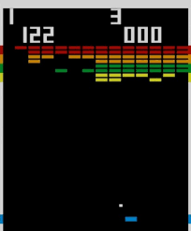
Asynchronous Advantage Actor Critic (A3C)
A3C is an asynchronous variant of the actor-critic algorithm, where multiple agents (actors) explore the environment simultaneously and update a shared value function (critic).
Example: Training an AI to play Atari games - Imagine you want to train an AI to play the classic Atari game "Breakout". - A3C would involve creating multiple instances of the game environment running in parallel. - Each instance (agent) explores the game independently, taking actions and receiving rewards. - Meanwhile, a central value network (critic) estimates the value of states and actions. - The agents periodically update the shared value function based on their experiences to improve the critic's accuracy. - Additionally, each agent updates its policy (actor) based on the advantage function, which measures the advantage of taking a specific action in a given state compared to the average. - Through asynchronous updates and the advantage signal, A3C efficiently learns a high-performing policy for playing Breakout.
Key Phrase: A3C leverages multiple agents to explore the environment simultaneously

Slide 18
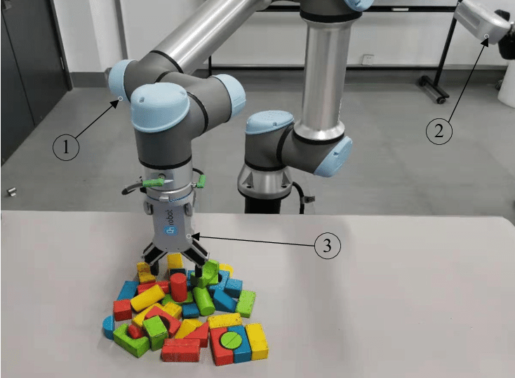
Soft Actor-Critic
SAC is an off-policy actor-critic deep reinforcement learning algorithm that optimizes a stochastic policy in an entropy-regularized manner. It aims to maximize the expected cumulative reward while also maximizing entropy (uncertainty) in the policy. Here's how it works:
Example: Training a robotic arm to manipulate objects with uncertainty - Imagine you have a robotic arm tasked with picking up objects in a cluttered environment. - SAC begins by collecting experiences from the environment, consisting of states, actions, rewards, and next states. - The algorithm learns two functions: a soft Q-function, estimating the expected cumulative reward, and a stochastic policy, mapping states to actions. - SAC encourages exploration by maximizing the entropy of the policy, promoting diverse actions and robustness to uncertainty. - During training, SAC updates the policy and Q-function parameters using the soft Bellman backup equation, incorporating both rewards and entropy into the objective. - By balancing exploration (maximizing entropy) and exploitation (maximizing expected reward), SAC efficiently learns a policy that can manipulate objects with uncertainty, adapting to various scenarios.
Key Phrase: SAC optimizes a stochastic policy while maximizing entropy, making it robust to uncertainty

Slide 19
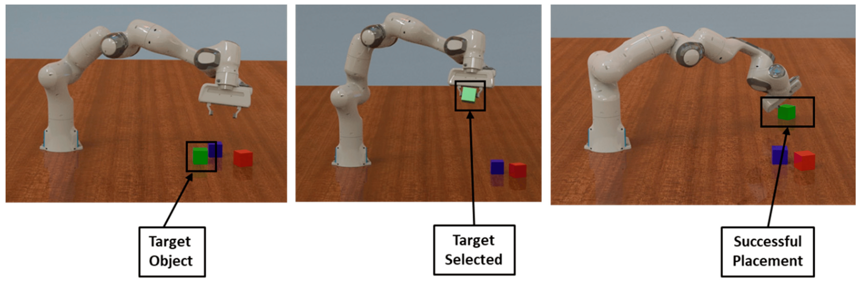
PPO ( Proximal Policy Optimization)
PPO is a policy optimization algorithm that aims to improve the stability and sample efficiency of policy gradient methods by constraining the policy updates. Here's how it works:
Example: Training a robotic arm to manipulate objects - Suppose you have a robotic arm in a simulated environment tasked with picking up and moving objects to specific locations. - PPO begins by collecting a batch of experiences by letting the robotic arm interact with the environment. - It computes the advantage of each action taken by the robotic arm using the rewards obtained and the estimated value function. - Instead of making large policy updates, PPO applies a clipped surrogate objective that limits the policy change to prevent large policy deviations. - This constraint ensures that the new policy doesn't deviate too far from the previous policy, maintaining stability during training. - By iteratively collecting experiences, estimating advantages, and updating the policy within the constrained region, PPO efficiently learns a robust policy for the robotic arm to manipulate objects effectively.
Key Phrase: Constrains policy updates to improve stability and sample efficiency.

Slide 20
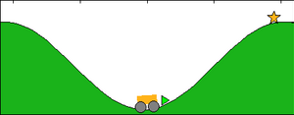
QLearning
Q-Learning is a model-free reinforcement learning algorithm that learns the optimal action-value function (Q-function) directly from experience without requiring a model of the environment. It estimates the expected cumulative reward of taking a particular action in a given state.
Example: Teaching a self-driving car to navigate intersections - Consider training a self-driving car to navigate intersections safely. - Q-Learning begins with initializing a Q-table (or Q-function approximator) that maps state-action pairs to their estimated values. - The car explores the intersection by taking actions (such as turning left, right, or going straight) and receiving rewards (positive for reaching the destination safely, negative for accidents or violations). - Q-Learning updates the Q-values using the Bellman equation, which combines the immediate reward with the discounted value of the next state-action pair. - Through iterative updates, the Q-values converge to their optimal values, representing the maximum expected cumulative reward for each state-action pair. - The self-driving car uses the learned Q-values to select actions that maximize its expected cumulative reward, enabling it to navigate intersections safely and efficiently.
Key Phrase: Learns the optimal action-value function directly from experience, enabling agents to make decisions that maximize expected cumulative rewards in various scenarios
Mountain Car Problem

Slide 21
Popular large language models(LLM):
GPT-3 (Generative Pre-trained Transformer 3) – This is one of the largest Large Language Models developed by OpenAI. It has 175 billion parameters and can perform many tasks, including text generation, translation, and summarization.
BERT (Bidirectional Encoder Representations from Transformers) – Developed by Google, BERT is another popular LLM that has been trained on a massive corpus of text data. It can understand the context of a sentence and generate meaningful responses to questions.
XLNet – This LLM developed by Carnegie Mellon University and Google uses a novel approach to language modeling called “permutation language modeling.” It has achieved state-of-the-art performance on language tasks, including language generation and question answering.
T5 (Text-to-Text Transfer Transformer) – T5, developed by Google, is trained on a variety of language tasks and can perform text-to-text transformations, like translating text to another language, creating a summary, and question answering.
RoBERTa (Robustly Optimized BERT Pretraining Approach) – Developed by Facebook AI Research, RoBERTa is an improved BERT version that performs better on several language tasks.

Slide 22
How do they work? –LLM Ops
Large language models like GPT-3 (Generative Pre-trained Transformer 3) work based on a transformer architecture. Here’s a simplified explanation of how they Work:
Learning from Lots of Text: These models start by reading a massive amount of text from the internet. It’s like learning from a giant library of information.
Innovative Architecture: They use a unique structure called a transformer, which helps them understand and remember lots of information.
Breaking Down Words: They look at sentences in smaller parts, like breaking words into pieces. This helps them work with language more efficiently.
Understanding Words in Sentences: Unlike simple programs, these models understand individual words and how words relate to each other in a sentence. They get the whole picture.
Getting Specialized: After the general learning, they can be trained more on specific topics to get good at certain things, like answering questions or writing about particular subjects.
Doing Tasks: When you give them a prompt (a question or instruction), they use what they’ve learned to respond. It’s like having an intelligent assistant that can understand and generate text.

Slide 23
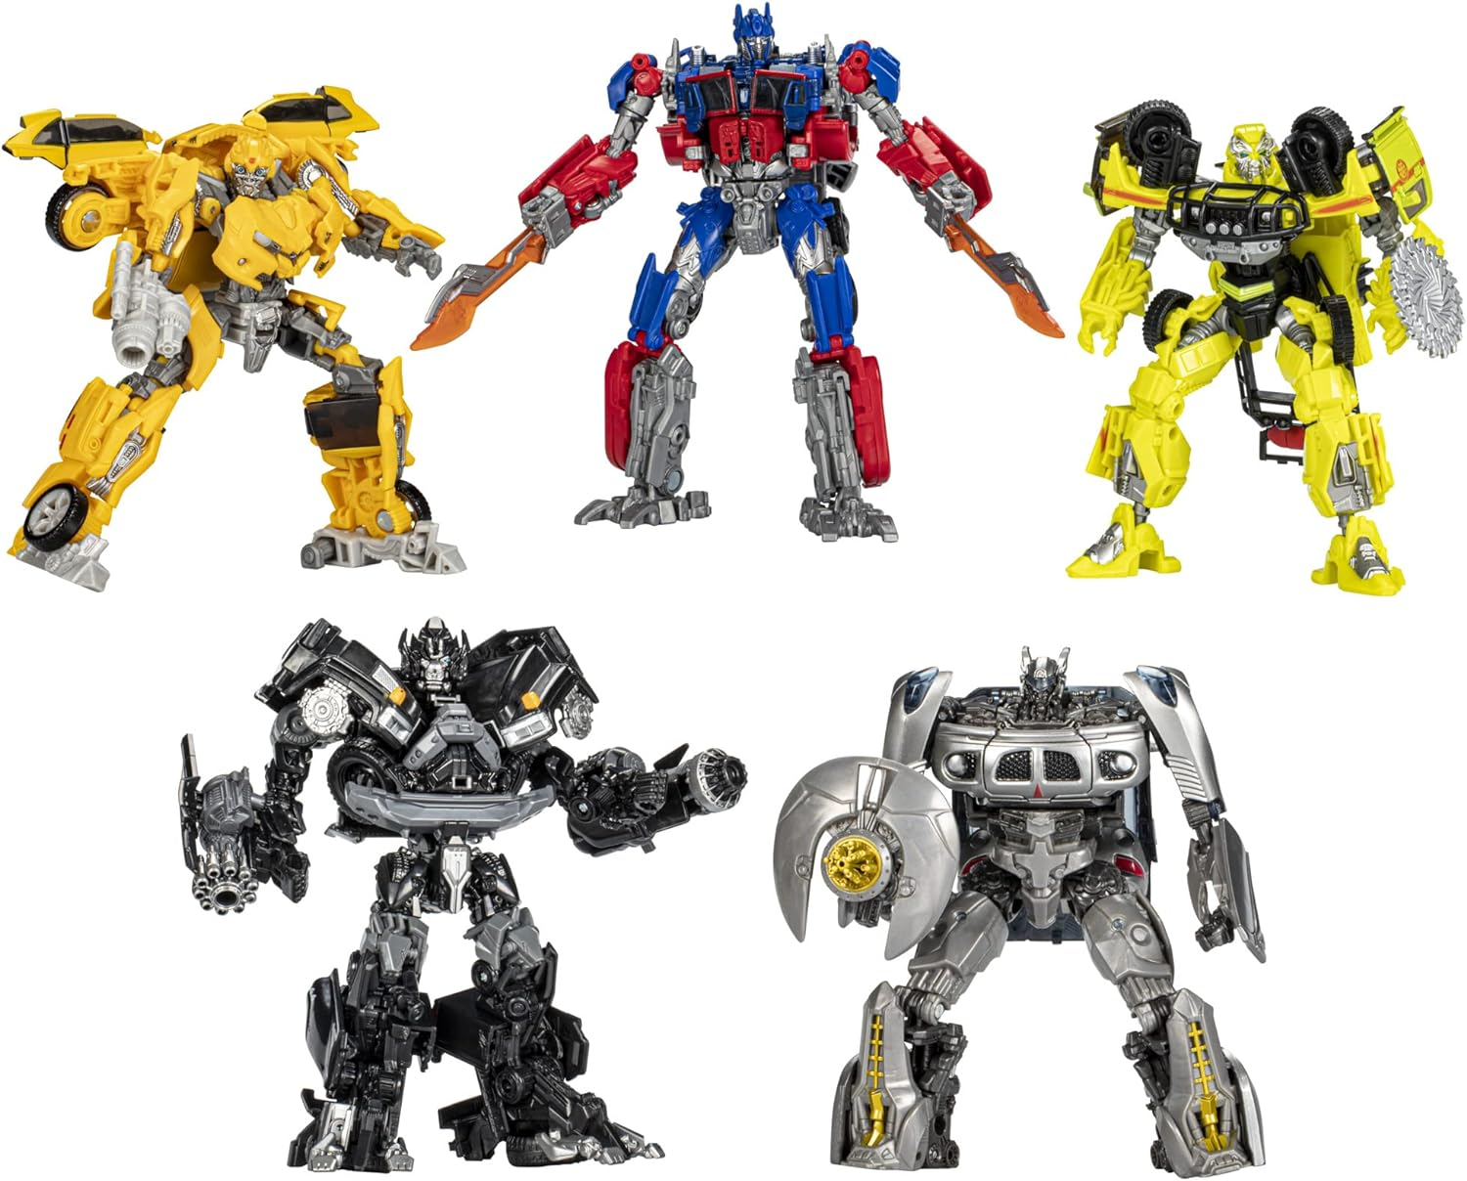

Transformers
(Neither of these)

Slide 24
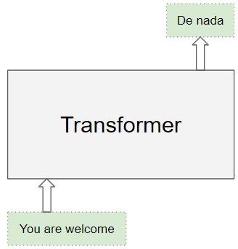

Origin and basics
The Transformer was proposed in the paper Attention is All You Need.
The Transformer architecture excels at handling text data which is inherently sequential.
They take a text sequence as input and produce another text sequence as output.
eg. to translate an input English sentence to Spanish.
The Transformer – a model that uses attention to boost the speed with which these models can be trained.

Slide 25
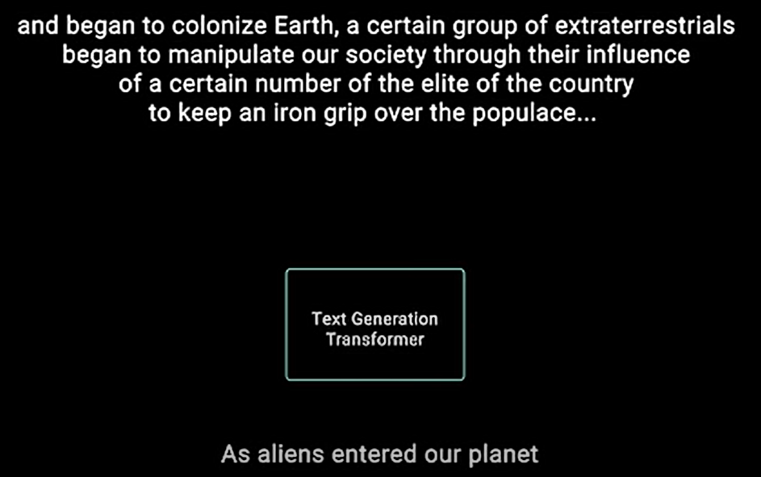
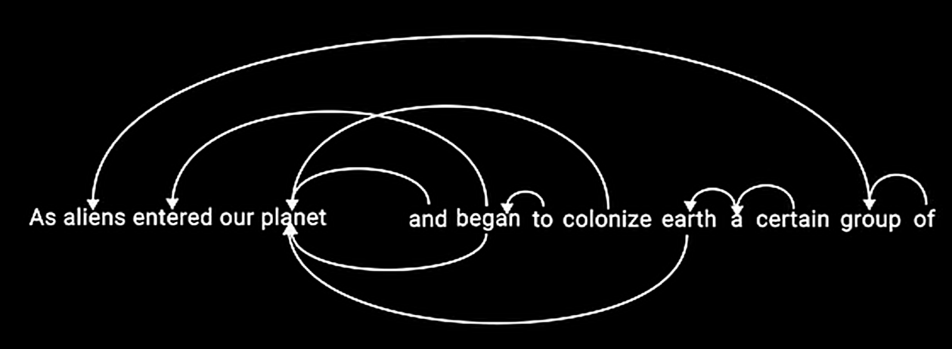
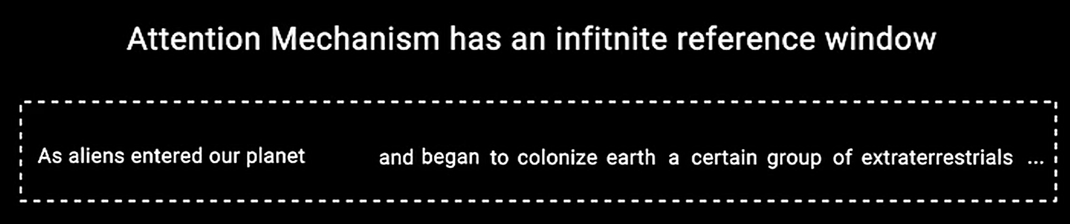
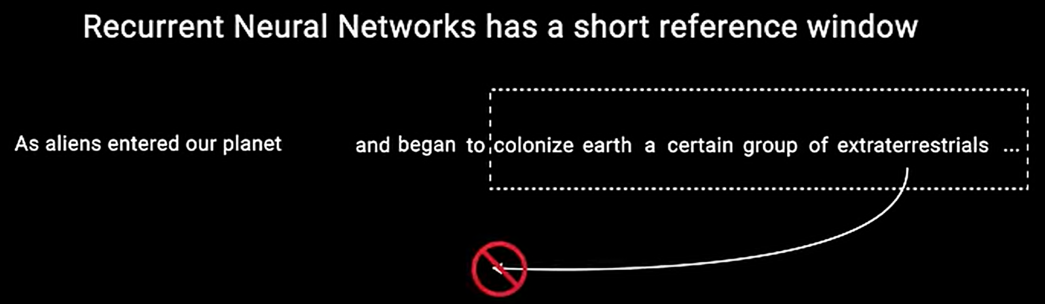
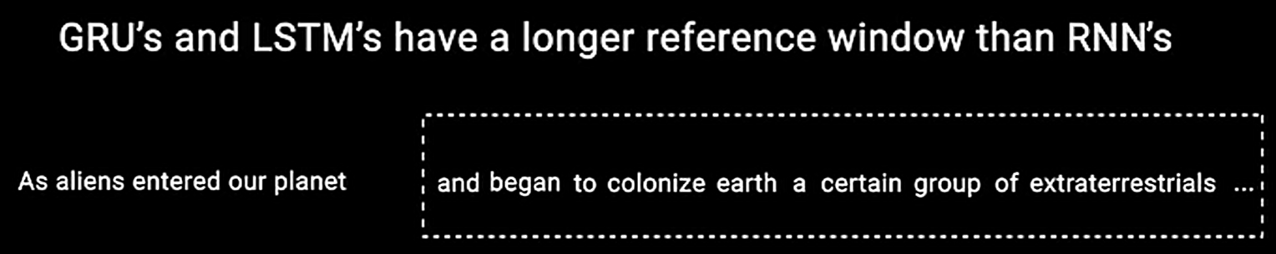
Attention (You can stand at ease)

Slide 26

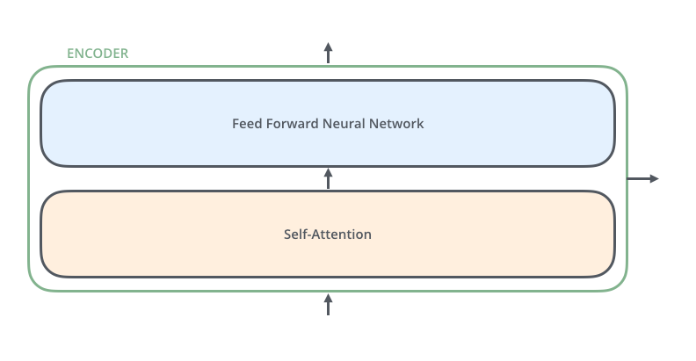
The encoding component is a stack of encoders (the paper stacks six of them on top of each other
There’s nothing magical about the number six, one can definitely experiment with other arrangements).
The decoding component is a stack of decoders of the same number.
The encoders are all identical in structure (yet they do not share weights). Each one is broken down into two sub-layers:

Slide 27

Encoder and Decoder
The encoder’s inputs first flow through a self-attention layer – a layer that helps the encoder look at other words in the input sentence as it encodes a specific word.
The outputs of the self-attention layer are fed to a feed-forward neural network. The exact same feed-forward network is independently applied to each position.
The decoder has both those layers, but between them is an attention layer that helps the decoder focus on relevant parts of the input sentence (similar what attention does in seq2seq models).

Slide 28

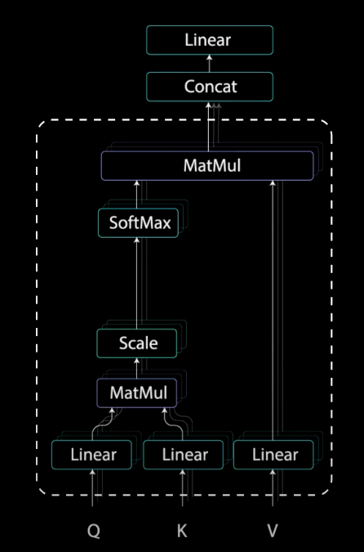
Self Attention
Say the following sentence is an input sentence we want to translate:
”The animal didn't cross the street because it was too tired”
What does “it” in this sentence refer to?
Is it referring to the street or to the animal?
It’s a simple question to a human, but not as simple to an algorithm.
When the model is processing the word “it”, self-attention allows it to associate “it” with “animal”.
As the model processes each word (each position in the input sequence), self attention allows it to look at other positions in the input sequence for clues that can help lead to a better encoding for this word.
If you’re familiar with RNNs, think of how maintaining a hidden state allows an RNN to incorporate its representation of previous words/vectors it has processed with the current one it’s processing.
Self-attention is the method the Transformer uses to bake the “understanding” of other relevant words into the one we’re currently processing.
Check out the Tensor2Tensor notebook

Slide 29
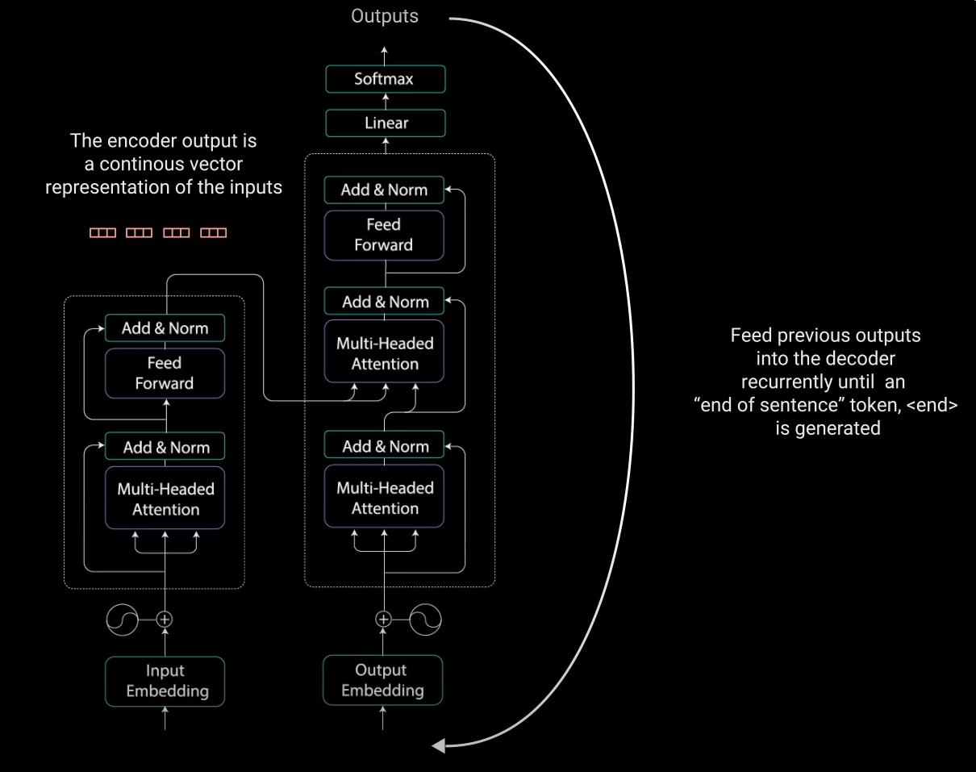
How does it have infinite attention?

Slide 30
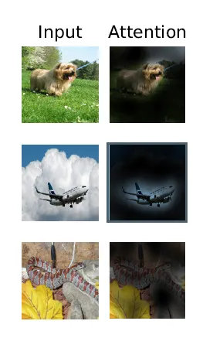
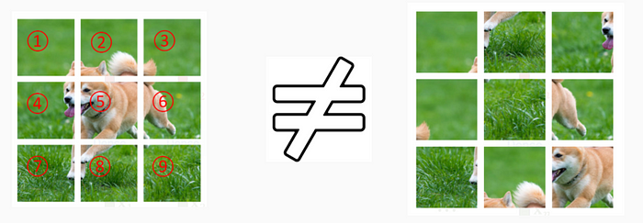
Vision Transformer
Why is positional encoding necessary?
Transformers are not capable of remembering the order or sequence of the inputs. If the image patches are re-ordered the meaning of the original image is lost.
Hence, we add a positional embedding to our linearly embedded image patches to keep track of the sequence.

Slide 31
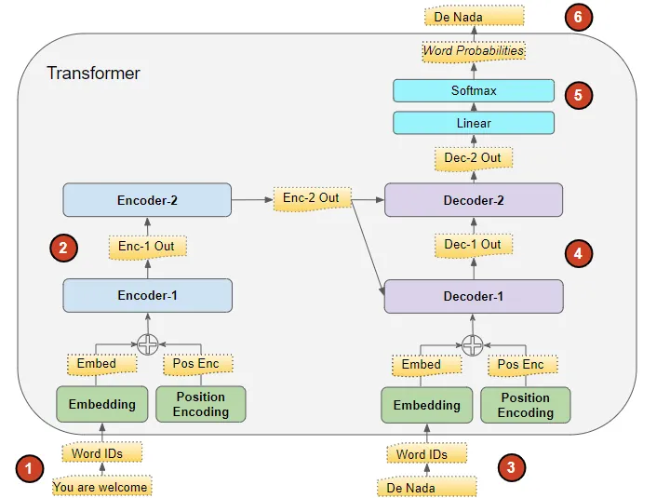
Training a Transformer
The Transformer processes the data like this:
The input sequence is converted into Embeddings (with Position Encoding) and fed to the Encoder.
The stack of Encoders processes this and produces an encoded representation of the input sequence.
The target sequence is prepended with a start-of-sentence token, converted into Embeddings (with Position Encoding), and fed to the Decoder.
The stack of Decoders processes this along with the Encoder stack’s encoded representation to produce an encoded representation of the target sequence.
The Output layer converts it into word probabilities and the final output sequence.
The Transformer’s Loss function compares this output sequence with the target sequence from the training data. This loss is used to generate gradients to train the Transformer during back-propagation.

Slide 32
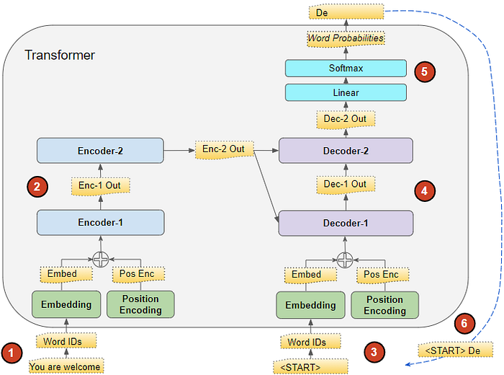
Transformer - Inference
The flow of data during Inference is:
The input sequence is converted into Embeddings (with Position Encoding) and fed to the Encoder.
The stack of Encoders processes this and produces an encoded representation of the input sequence.
Instead of the target sequence, we use an empty sequence with only a start-of-sentence token. This is converted into Embeddings (with Position Encoding) and fed to the Decoder.
The stack of Decoders processes this along with the Encoder stack’s encoded representation to produce an encoded representation of the target sequence.
The Output layer converts it into word probabilities and produces an output sequence.
We take the last word of the output sequence as the predicted word. That word is now filled into the second position of our Decoder input sequence, which now contains a start-of-sentence token and the first word.
Go back to step #3. As before, feed the new Decoder sequence into the model. Then take the second word of the output and append it to the Decoder sequence. Repeat this until it predicts an end-of-sentence token. Note that since the Encoder sequence does not change for each iteration, we do not have to repeat steps #1 and #2 each time

Slide 33


Slide 34
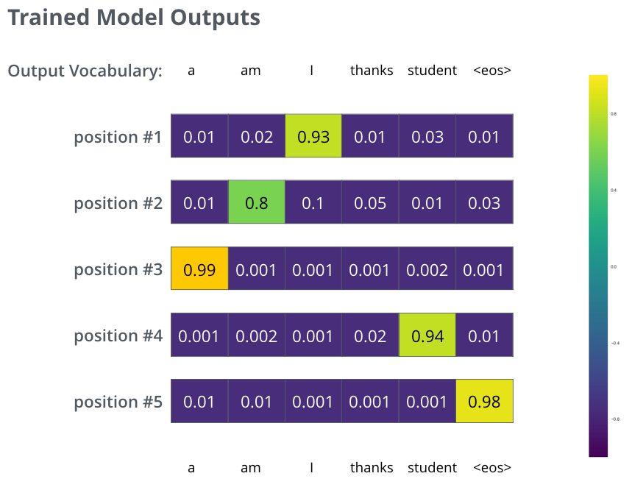
The Final Linear and Softmax Layer
The decoder stack outputs a vector of floats. How do we turn that into a word? That’s the job of the final Linear layer which is followed by a Softmax Layer.
The Linear layer is a simple fully connected neural network that projects the vector produced by the stack of decoders, into a much, much larger vector called a logits vector.
Let’s assume that our model knows 10,000 unique English words (our model’s “output vocabulary”) that it’s learned from its training dataset.
This would make the logits vector 10,000 cells wide – each cell corresponding to the score of a unique word. That is how we interpret the output of the model followed by the Linear layer.
The softmax layer then turns those scores into probabilities (all positive, all add up to 1.0).
The cell with the highest probability is chosen, and the word associated with it is produced as the output for this time step.

Slide 35
NLP
Natural Language Processing
Focuses on the interaction between computers and humans through natural language

Slide 36
About NLP
We can't say that we often think about the subtleties of our language. It is an intuitive behavior that relies on semantic cues such as words, signs, or images to convey information and meaning
Also, languages do not follow strict rules and have many exceptions.
Language acquisition, while natural for humans, is extremely complex for computers because it has a lot of unstructured data, a lack of strict rules, and no concrete perspective or context.
Yet, humans increasingly rely on computer systems to communicate and perform tasks.
NLP is a component of AI that focuses on understanding human language as it is written and/or spoken. To do this, specific computer programs are developed; a typical computer requires instructions to be conveyed in a very precise, marked-out, structured, and unambiguous programming language.
Unfortunately, natural human language is imprecise, equivocal, and confusing. To enable a program to understand the meaning of words, it is necessary to use algorithms capable of analyzing the meaning and structure to make the words understandable, recognize certain references, and then generate the language.

Slide 37
What Can Natural Language Processing Do?
Messaging Filters – Truecaller, OTP
Intelligent Assistants – Siri, Alexa
Search Results – Sentence to Keywords
Intuitive Typing – Autocomplete
Translation
Digital Phone Calls - ’this call may be recorded for training purposes‘
Text Analytics – Sentiment Analysis

Slide 38
NLP techniques and methods
To analyze and understand human language, NLP employs a variety of techniques and methods. Here are some fundamental techniques used in NLP:
Tokenization. This is the process of breaking text into words, phrases, symbols, or other meaningful elements, known as tokens.
Parsing. Parsing involves analyzing the grammatical structure of a sentence to extract meaning.
Lemmatization. This technique reduces words to their base or root form, allowing for the grouping of different forms of the same word.
Named Entity Recognition (NER). NER is used to identify entities such as persons, organizations, locations, and other named items in the text.
Sentiment analysis. This method is used to gain an understanding of the sentiment or emotion conveyed in a piece of text.

